Slide 1
Welcome!
Agenda
Meet the Board
  Bob Guarino – President – General Chapter news; Bylaws; 2025 Chapter Board; Website Demo
  Traves Holland - Secretary – Organizing and Documenting Board Activities
  Ana White – Treasurer – Financial Update
  Steve Hewitt – VP of Events – 2024 Event Plans and Schedule
  Pandu Gupta – VP of Education and Professional Certification – Study Groups and Professional Development
  Tejas Sriprasad – VP of Membership – Interesting Membership Facts and Figures; IIBA Membership Benefits;
  Vu Nguyen – VP of Communications, Marketing and Sponsorship – Sponsorship and Social Media Activity
Sacramento Valley Chapter Web Site Demo
Job Market Update and Job Openings
Open Forum and Q&A
Raffles

Slide 2
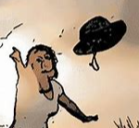

First, Throw Your Hat into the Ring to Secure a Spot on Our Raffle Prize Wheel!

Slide 3
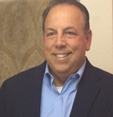
President
Bob Guarino
Bob has been at Blue Shield of California for 12 years.
He has been in his current Business Analyst Consultant position for 7 years.
He has been involved with the board for the past 7 years.
Responsibilities:
Overseeing the activity of the other board members.
Representing the chapter at the monthly regional chapter web meetings.
Documenting discussion and decision made at board meetings.
Generating ideas and providing input about chapter activities.

Slide 4
Bylaws
The IIBA Sacramento Valley Chapter formed in 2010.
Our bylaws are the governing rules in which we operate
As things evolve, so must our bylaws.
We are ready to release version 13.
First, we need your review and comments on the draft for version 13.
Please check the bylaws posted to our web page: Governance & By Laws | IIBA Sacramento
These bylaws are open for review and comment until 1/31/2024.
Any questions or comments should be directed to president@sacramento.iiba.org.

Slide 5
2025 Board and Shadowing Opportunities
We are already planning for our 2025 board.
Many of the current board members have been in the current position for several years.
To ensure continuity of our chapter, we starting early to plan for the next year.
We are seeking volunteers who may want to just help out in certain areas.
We are also seeking people who may be interested in a specific board position and is will to “shadow” a current board member.
You will find more info on the responsibilities and activities of each board position here:
Board of Directors Position Responsibilities 01-16-2024.pdf (iiba.org)
If you are interested, please contact Bob at president@sacramento.iiba.org.

Slide 6
General Items of Interest
Sacramento Valley Chapter website
IIBA is changing the way you will interact with the local IIBA Chapters.
The Sacramento Valley Chapter site will not be impacted until later this year.
Meeting Administration and Attendance Tracking
IIBA is moving towards implementing “Member Nova”. It is a new platform for registering and attending events. This platform will make signup and payment collection easier. It will also allow for automatic tracking of meeting attendance and automatically capture your CDU credits in your IIBA profile
Chapter Web Site Demo. Home page: IIBA Sacramento |
Menu Item | Content
About Us | Board of Director Bios and Bylaws
Get Involved | Membership (IIBA International); Sponsorship; Volunteer Signup
Certification | Links over to IIBA International Certification Page
Careers | Operational Content (Meeting slides, Event Schedule, Study Groups and much more); Job Postings; Study Group Signup, Webinars
Events | Event Calendar
News | Any Newsworthy Items of Interest

Slide 7
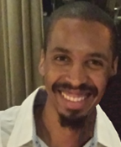
Secretary
Traves Holland
Traves has worked at VSP for 10 years.
He has been in his current Business Analyst position for 5 years.
He has taken on the Board Secretary position to be more active in the Chapter.
Responsibilities:
Pulling together topics for the monthly board meetings
Scheduling and facilitating board meetings.
Documenting discussion and decision made at board meetings.
Generating ideas and providing input about chapter activities.

Slide 8
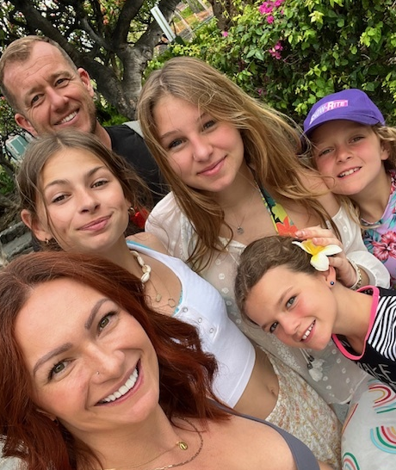
Treasurer
Ana White
Ana has been employed with VSP for 12 Years, 10+ as an analyst and currently in management. This role allows her to work with and learn from many different business areas as she navigates recommendations for improvements within the organization.
Outside of VSP, she is President with Sierra Gold Soccer Club in Placerville, CA. She also assists local small businesses with business planning, website assistance, bookkeeping, and general ideas to improve business processes and best practices. Community involvement and providing opportunities for youth motivates her greatly.
Ana’s 4 daughters keep her on her toes and when she is not working or volunteering you can find her on the soccer field or starting DIY home renovations!
Responsibilities:
Keeping our financial house in order, timely filing of all financial and business artifacts, maintaining and monitoring our PO Box

Slide 9
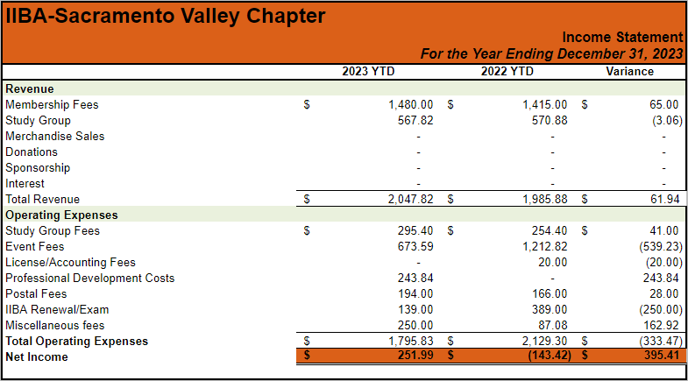
Financial Report for Year Ending 12-31-2023

Slide 10
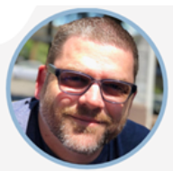
VP of Events
Steve Hewitt
Steve Hewitt has worked as a Senior Business Analyst at VSP for the past nine years. In 2020. he earned his Six Sigma Green Belt. He has a Bachelor of Science degree in Business Administration with a minor in Human Resources from California State Sacramento.
Steve is passionate about leveraging his experience and skills to support the Sacramento Valley Chapter’s mission and vision. Outside of work, Steve has two adult children – a Sophomore at Folsom Lake College and a Senior at Sonoma State University. He and his wife run a small business in Folsom & Cameron Park.
Responsibilities:
Planning, promoting, and running our awesome monthly events!

Slide 11
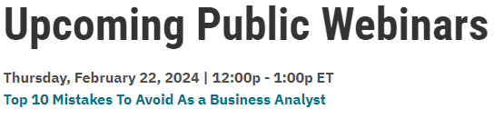
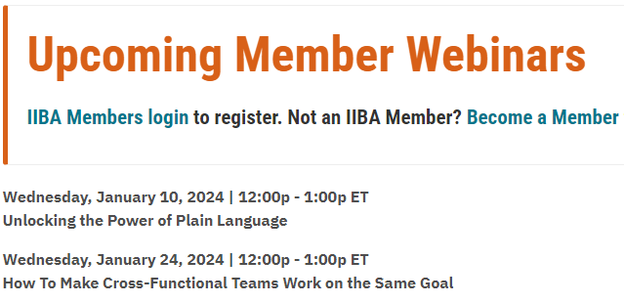
2024 Monthly Member Event Schedule (Wednesdays)
Date | Time | Topic
Jan 17 | 5:30pm – 6:30pm | Annual General Meeting
Feb 21 | 5:30pm – 7:00pm | Your BA Career
Mar 20 | 5:30pm – 7:00pm | TBD
Apr 17 | 5:30pm – 7:00pm | TBD
May 15 | 5:30pm – 7:00pm | TBD
July 17 | 5:30pm – 7:00pm | TBD
Aug 21 | 5:30pm – 7:00pm | TBD
Sept 18 | 5:30pm – 7:00pm | TBD
Oct 16 | 5:30pm – 7:00pm | TBD
Nov 20 | 5:30pm – 7:00pm | TBD
Global IIBA Events
Attend any Chapter’s Events
Free & Member Only Webinars
Initially, all meetings will be web based. We may consider in-person events later in the year
We may have an in-person networking event in June.
We may partner with the Sacramento PMI Group for a joint in-person mixer event at some point in 2024.
Do you have a topic you would like to see or even present? Please Contact Steve at Events@sacramento.iiba.org

Slide 12
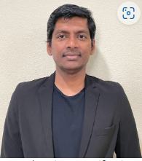
VP of Education and Professional Certification
Pandu Gupta
CBAP, AAC and PMP certified
Senior QA Consultant at ClearBest
Health Insurance and Social Welfare Benefits based projects
System Analysis and Functional Analysis expertise
Passion for Excel-based projects
Responsibilities:
Champion for the professional development of our members.
Planning, promoting, and running our BABOK and Agile Study Groups.
Ensuring our members are aware of educational opportunities and available certifications.

Slide 13
2024 BABOK Study Group Info and Schedule
Certifications
  Attaining certification shows your commitment to your professional growth.
  Certified BAs generally contribute more, earn more, and progress faster than those who are not certified.
  Some job descriptions are calling for IIBA certifications.
BABOK (Business Analysis Body of Knowledge) Version 3 Study Group
  BABOK Version 3 is the basis for the ECBA, CCBA, and CBAP certifications.
  Each certification has its own requirements (which will be covered as part of the study group materials).
  Complete coverage of the BABOK (Business Analysis Body of Knowledge) Version 3.
  All sessions are web based and after normal working hours.
  There are 17 Wednesday sessions. The first 15 sessions are from 6PM – 8 PM. The last 2 sessions are from 6PM – 8:30PM.
  You will earn 35 PD (Professional Development) hours if you attend all sessions. These hours will satisfy the requirement to apply to take the CBAP test.
  The cost to join the BABOK Study Group is $75 for the entire 17 session program.
  More information and the signup form are on the Sac Valley IIBA website: Join our 2024 Spring BABOK Study Group | IIBA Sacramento.
Agile Study Group to prepare you for the AAC Certification Test
  This study group will be start later this year. More details will be forthcoming.

Slide 14
2023 Study Group Statistics
2024 Study Group Plans
Spring BABOK Study Group
  March 1 through June 7
  14 sessions
  13 participants
Fall AAC Study Group
  October 25 through December 13
  7 sessions
  12 participants
Spring BABOK Study Group
  March 6 through July 31
  17 sessions
  Maximum 20 participants
Fall AAC Study Group
  October – December timeframe
  7+ sessions
  Maximum 15 participants
Why should you join IIBA-SVC Study Group?
IIBA Global training materials
Knowledge Check Quizzes
Watermark Learning exam practice enrollment (40% discount)

Slide 15
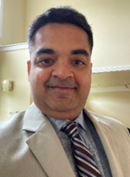
VP of Membership
Tejas Sriprasad
Tejas has 16 years of experience as business analyst primarily in the hedge fund and banking industry working with developers and testers and subject matter expert in finance technology working in Agile, Waterfall and Rup methodologies, writing functional and non-functional requirements, business requirements.
Responsibilities:
Monitoring and analyzing monthly Sacramento Valley IIBA membership.
Working with the other board members to ensure they have the latest membership updates and can strategically use it for the benefit of the chapter.

Slide 16
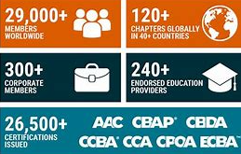
IIBA Membership
Membership cost is $139 per rolling calendar year.
$15 goes to support your designated local chapter.
If you join, please select “Sacramento Valley Chapter” as your local chapter.
Benefits of joining:
Access a free PDF copy of the BABOK Guide v3.
Access a free copy of the Agile Extension to the BABOK V2.
Access a free copy of the BA Competency Model.
Connect and learn with other professionals at Chapters around the world (All 120+ Chapter-level memberships globally are included with your IIBA Membership).
Member exclusive webinars.
Digital Online Library - featuring 11,000+ titles.
PDF publications, articles, industry papers and reports.
Savings of up to 40%* on globally recognized professional certifications.
Networking opportunities, support and resources, and ongoing professional development.
Keep current and involved with professional practices and developments.
You are able to join the Sacramento Valley Chapter BABOK and Agile Study Groups.

Slide 17
Sacramento Valley Chapter Membership Info
As of January 1, 2024, we have 109 active members from 45 different organizations,
Additional demographics:
# Mbrs | Category
18 | CBAP – Certified Business Analysis Professional
2 | CCBA – Certification of Capability in Business Analysis
8 | ECBA – Entry Certificate in Business Analysis
2 | AAC – Agile Analysis Certification
10 | IIBA Corporate Members

Slide 18
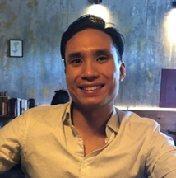
VP of Communications, Marketing, and Sponsorship
Vu Nguyen
Vu is dedicated to delivering quality technology services with integrity and reliability. He has 5+ years’ experience in providing technology and workforce consulting services. As a Technical Recruiter with Experis, Vu assists candidates in finding opportunities that match their unique skillsets. He stays informed with industry trends by participating in professional conferences. His industry experience includes state and local government, healthcare, education, technology, insurance, manufacturing, and logistics.
He has a passion for people, technology and the development of people’s careers paths and delivering a meaningful experience for his candidates.
Responsibilities:
Establishing and maintaining relationships with our sponsors.
Communicating and promoting the activities of the chapter.
Providing an “on the ground” picture of the current job market.

Slide 19





Sacramento Valley Chapter 2024 Sponsorship
Monthly Meeting Support – Logistics and Raffle Prizes
Note: Images have web links
Monthly Meeting Support - Presentation Content
BABOK and Agile Study Group Support (Newly Added for 2024!)

Slide 20
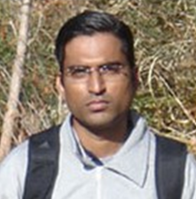
Volunteer, Webmaster
Turab Fatakdawala
Turab is a Senior Product Manager with PowerSchool. He has been volunteering for the IIBA Sacramento Valley Chapter as the Webmaster and handling all technology activities for the past eight years.
He is an Engineer, has his MBA, and loves the Education industry where all his work experience lies.
He actively supports Boy Scouts of America as an Assistant Scout Master and regularly donates with Vitalant.
Contributions:
Keeping our website current and in good working order.
Managing security for email accounts, social media, and shared folder sites.
Running the board nominations and board election process.

Slide 21
Job Market Update and Job Openings
Update from Experis
Open floor for any other known opportunities

Slide 22




Slide 23
Parting Thoughts
Your IIBA Sacramento Valley Chapter board is working hard for you!
Board ‘shadowing’ opportunities are available.
‘See’ you at the February 21st monthly member meeting.
IIBA Membership is a great deal!
Study Groups are a great deal!
Raffles!!

Slide 24

Final Chance!
Enter Your Name in the Meeting Chat Window

Slide 25


