Slide 1
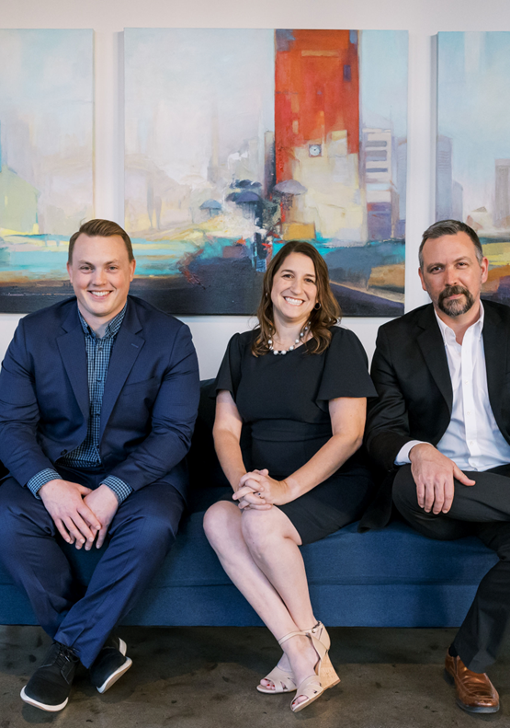
The Art of the Interview
Jason Roberts
July 19, 2023

Slide 2
Agenda
01
Set the Stage
02
Identify the Focus
03
Guide the Conversation
www.whythinkdev.com

Slide 3
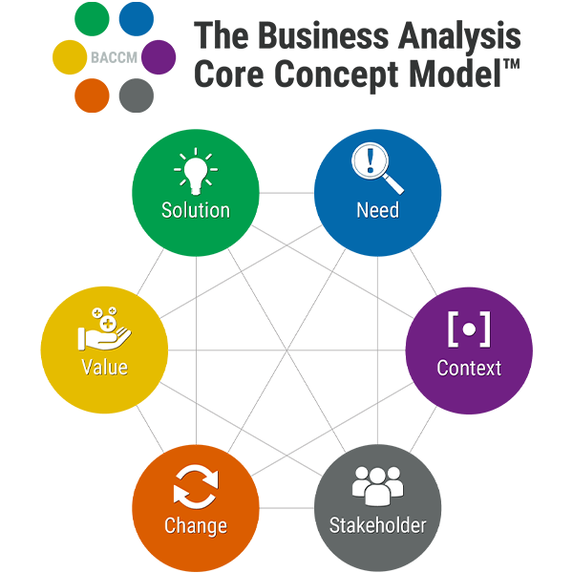

Slide 4
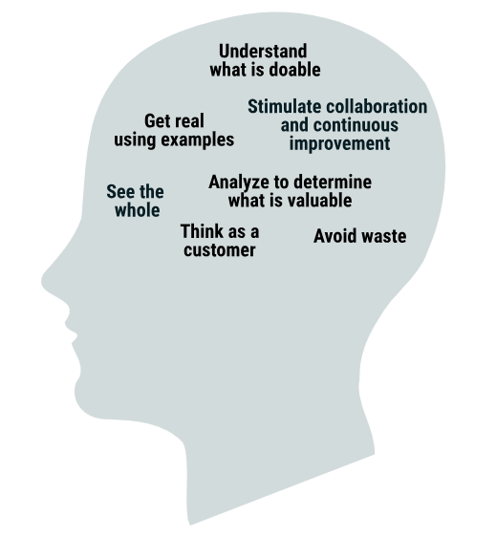

Slide 5
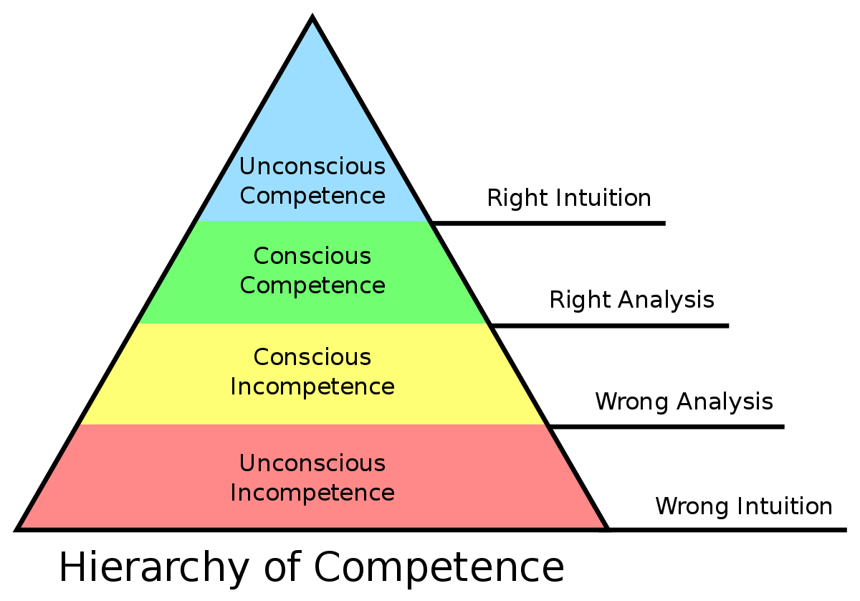

Slide 6
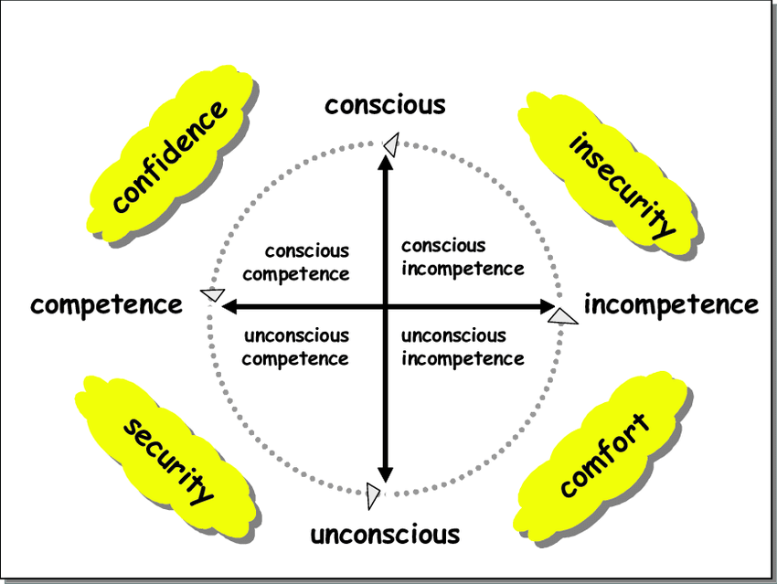

Slide 7
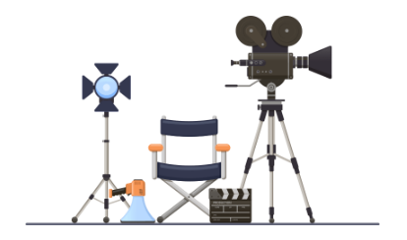
Set the Stage
Connect and Build Rapport
Build Trust
Provide psychological security
Observe
Be prepared
Listening deeply and actively

Slide 8
Active Listening Techniques
Paraphrasing
Reflecting
Checking for Meaning or Values
Tracking
Encouraging
Intentional Silence
Listen for themes, repeated phrases, common ground, WIIFM

Slide 9
Identify the Focus
Be present
State the topic/goal
Reinforce
Enhance
Develop
Describe context of situation together
Share impact of questions, thoughts, ideas

Slide 10
Qualities of Powerful Questions
Succinct and Focused
Transparent in Origin
Non-judgmental
Intentional and goal oriented
Grounded in solutions and not defense

